Slide 1
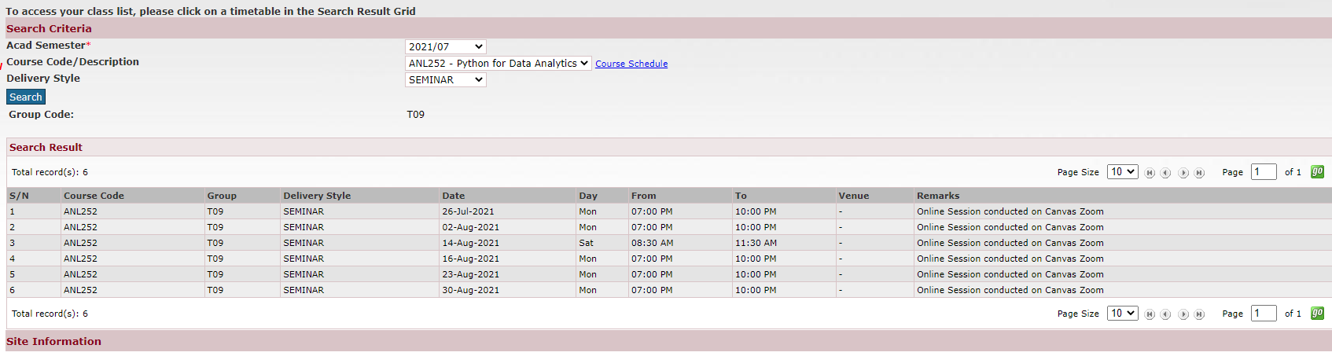
ANL252
Schedule

Slide 2
ANL252 – Assessments, weightage, deadlines
Time frame and Deliverables
Assessment | Weightage | Start date | Deadline
Pre-Course Quiz 1 | 2% | 19 July, 12pm | 30 July, 12pm
Pre-Class Quiz 1 | 2% | 2 Aug, 12pm | 9 Aug, 12pm
Pre-Class Quiz 2 | 2% | 16 Aug, 12pm | 23 Aug, 12pm
Tutor Marked Assignment | 18% |  | 8 Aug, 1155 pm
Group Based Assessment | 20% |  | 22 Aug, 1155 pm
End-of-Course Assessment | 50% |  | 6 September 2021, 12 pm
Participation | 6% (30% from class, 70% from forum)

Slide 3
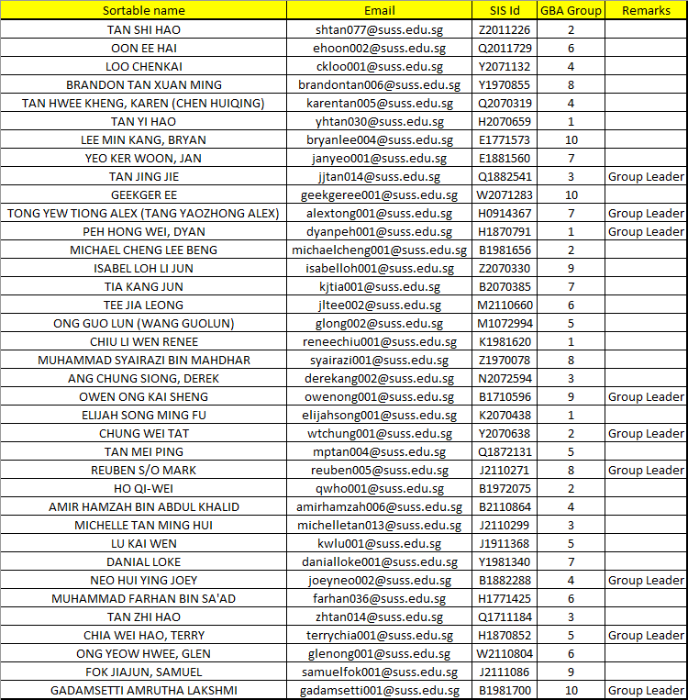
ANL252 – GBA Groups

Slide 4
Python for Data Analytics ANL 252
Faculty: Dr. Munish Kumar
Session 1: Intro to Python Programming
July 2021

Slide 5
Learning Objectives of ANL201
By the end of this Session
Execute Python from the PowerShell command line and run Python scripts written in Atom text editor
Solve problems using Python scripts with appropriate variable names, types and operations
Print output using formatted strings, format() method and escape sequences
Create user input and use it to implement appropriate operations
Compose appropriate Boolean expressions for given data scenarios
Use while-loop and for-loop correctly, and execute breaks when desired

Slide 6
Introductions
Name
Profession/ What you do/ What you like
Do you currently use python?
What would be one thing you want to take away from this class?

Slide 7

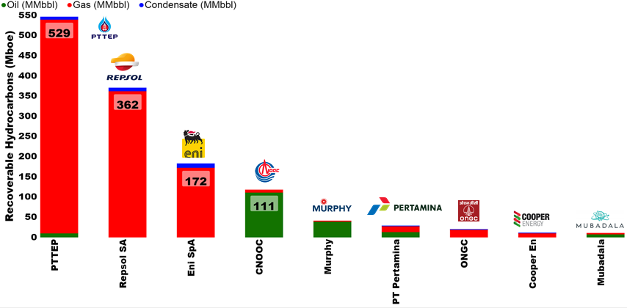
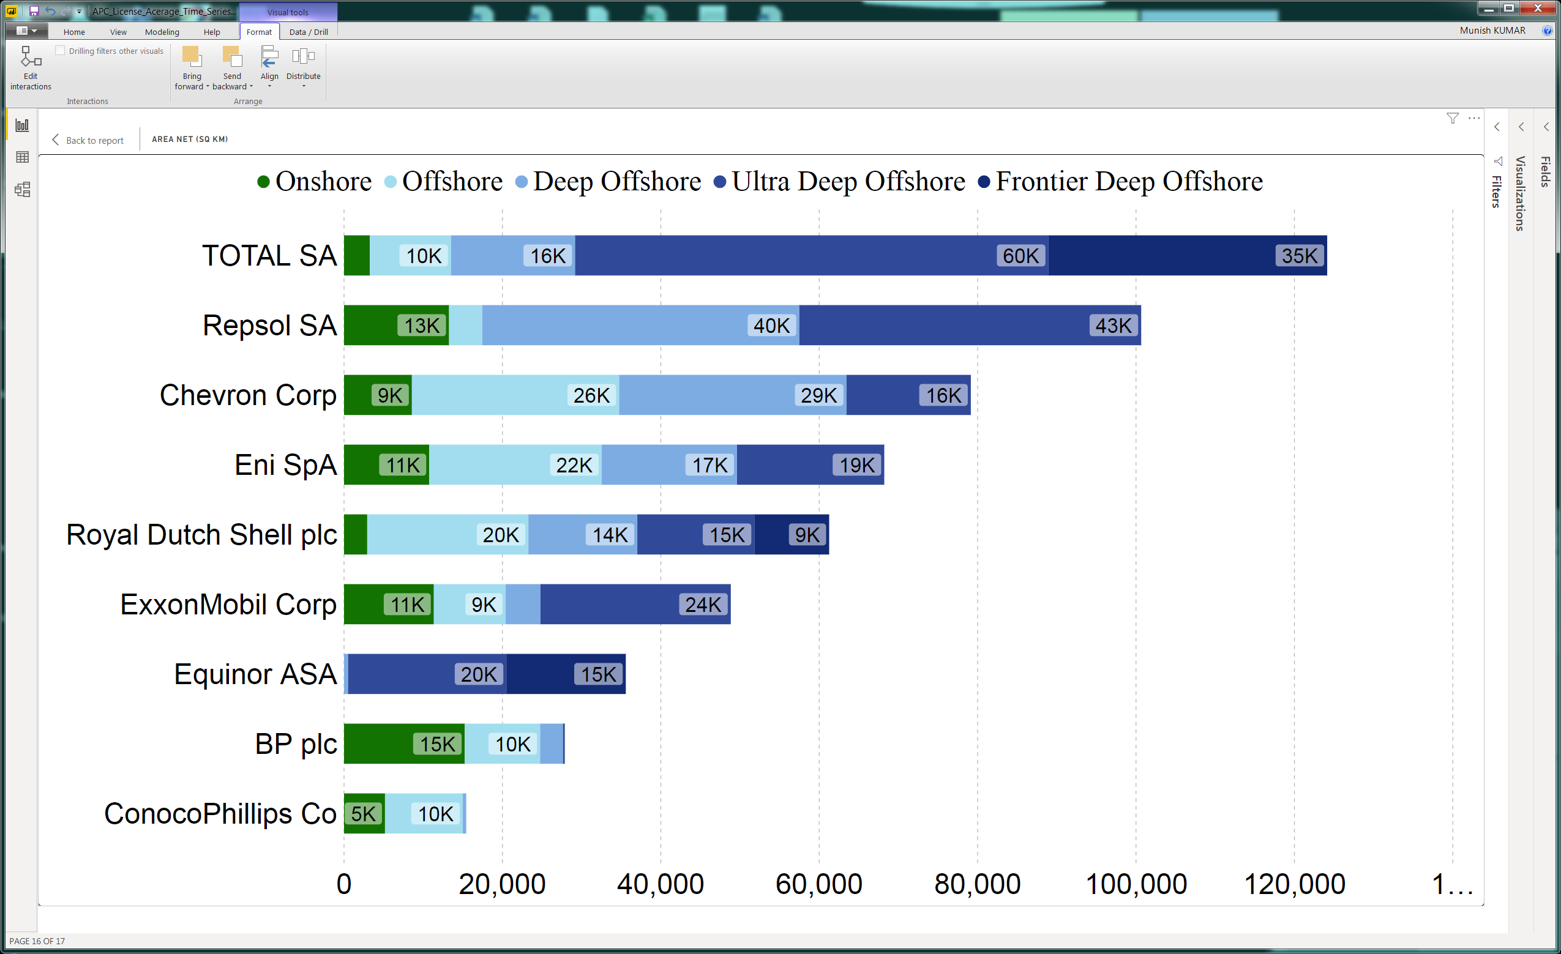
SUSS Associate faculty: Dr Munish Kumar
Email: munishkumar001@suss.edu.sg
Academic Qualification:
Ph.D. Physics, Australian National University
Courses taught at SUSS:
ANL201 Data Visualisation for Business
ANL488 Business Analytics Applied Project
ANL252 Python for Data Analytics
Active Area of Work/ Projects:
Energy Auditing (Reserves), Application of Data and Visualisation in Oil and Gas, Energy, Renewables Sector
Tools of the trade: Power BI & Python, Tableau.
.

Slide 8
Study Unit 1 Introduction to Python Programming

Slide 9
Python Programming Environment

Slide 10
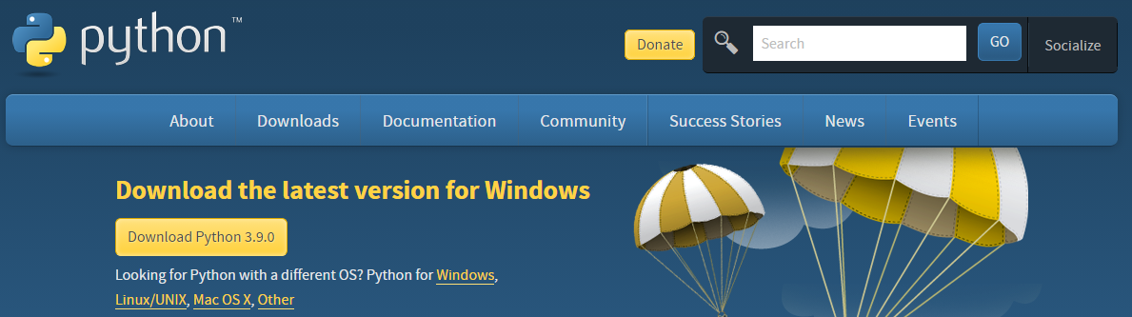
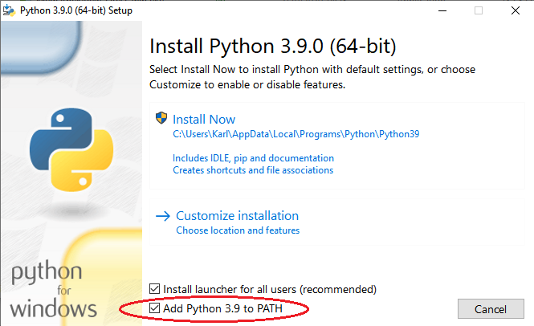
Installation of Python
Visit https://www.python.org/downloads/ and download Python installer.
For Windows installation, check the box “Add Python [Version] to PATH”.
Notes:
To download and install Python, you can visit the official website of Python and click on “Download Python”.
After downloading the installer, double-click on it, and the installation window will then appear.
Note that when installing it on Windows, ensure that the box “Add Python to PATH” is checked.

Slide 11
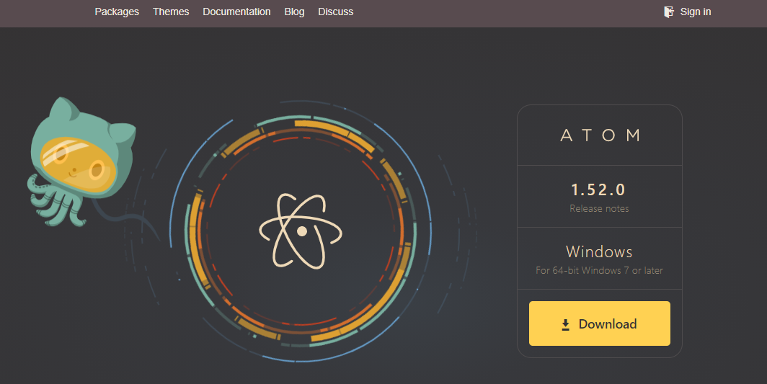
Installation of Atom
Download Atom text editor at https://atom.io and install it.
Notes:
Furthermore, we will need Atom as our editor for composing Python scripts.
Though we can also execute Python codes without writing them in an editor, it is much more convenient to do so. We can download Atom text editor at https://atom.io:
We can select the operating system that we prefer for the Atom installer. Press the “Download” button and install Atom by executing the installer after the download has completed.

Slide 12
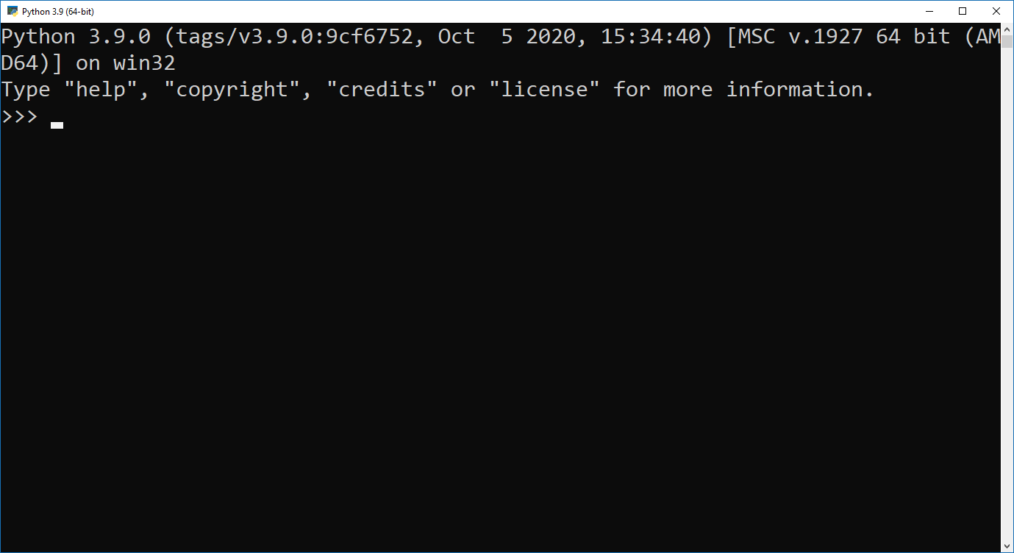
Write & Execute Python Programs (I)
Method I:
Open Windows start menu (or other relevant features on other OS).
Find Python in it and start the program.
Once “>>>” appears, type in Python command and then press ENTER to execute.
Notes:
After installation, we can start writing our Python program. One simple way is to write and run in Python directly, which we can find in the start menu.
Once we see the prompt, we can type in our Python command and let the Python interpreter execute it by pressing ENTER once the syntax is completed.

Slide 13
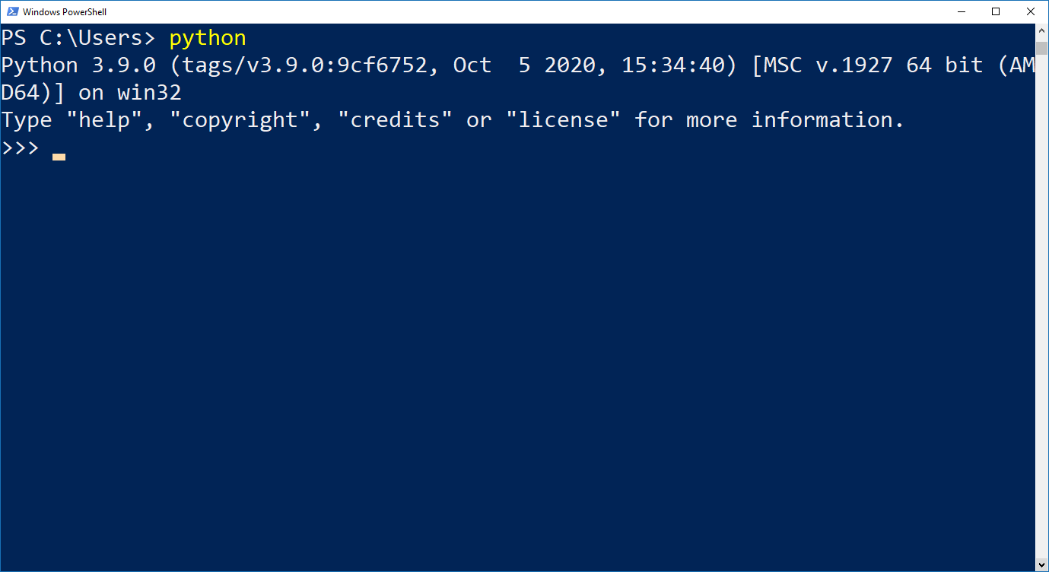
Write & Execute Python Programs (II)
Method II:
Type “PowerShell” or “Command Prompt” in the “Search Windows” box.
When “C:\>” appears, type in “python” and press ENTER.
Once “>>>” appears, type in Python command and press ENTER.
Notes:
Another way to run Python is to call it from a terminal app.
For this, we will need Windows PowerShell or Command Prompt to open it. Type “PowerShell” or “Command Prompt” in the “Search Windows” box on the task bar.
For simplicity, we will use Windows PowerShell in the following. Type “python” in PowerShell and then press ENTER.
Once the Python interpreter has been started, we can see a very similar screen layout as shown here.
Now we can type in our Python code and immediately see the output once we have pressed ENTER. For instance, if we would like to do a simple calculation such as 2 + 7, we simply type in this equation and press ENTER.
Python will interpret what we have typed in and print the result in the next line.
After we have finished executing our Python programs, we can quit Python by entering quit() and then press ENTER. We will return to the prompt of the operating system same as what we had seen before we started Python.

Slide 14
Write & Execute Python Programs (III)
Method III:
Start atom.
Write the Python commands and save the script as “.py” format file.
Comments put in Python scripts start with a hash (#).
Start Windows PowerShell.
Run the script by executing the command:
python filename.py
Notes:
Apart from interactively working with the Python interpreter, we can also let Python run our own program scripts. These scripts are text files saved with the extension .py.
In these script files, we put all the Python codes to be executed in a batch, instead of typing in and executing the syntax line by line in the interpreter.
One obvious advantage of using a script file is that in most of the cases, we may intend to do couple of calculations and data manipulation steps before asking Python to return the final output to us.
Some of these executions could be quite inconvenient, or perhaps even impossible, when we must run them line by line.
Once our Python scripts is completed in Atom, we can then execute them using the python command in PowerShell.
Another advantage of writing Python code in a script is that we can add comments to it. Comments are lines in a script that will not be executed by Python.
We can use comments to explain the procedures that the Python code is executing. Including comments is important since they will make it more readable and understandable for future editing or debugging, and the overall maintenance of the program.
Comments in Python scripts start with a hash (#). After the hash, we can type in our explanations or descriptions of the referred syntaxes.
Comments can be placed as a complete single line or after a line of syntax. If we need multiple lines for longer comments, we will have to start every comment line with a hash.
After editing the Python commands in a script using Atom, save the script with the extension .py.
Different from the Python interpreter, we need to use the print() function explicitly to generate an output when Python executes the script.
In PowerShell, we need to change to the directory where we have saved the Python script, and then run the script by executing the command python filename.py, where filename can be any file name of our Python script.

Slide 15
Basic Arithmetic and Variables

Slide 16
Arithmetic Operators
Python can carry out very sophisticated tasks.
But we can also use it as a simple calculator.
Operator | Function
+ Addition | Adds values on either side of the operator.
- Subtraction | Subtracts right hand operand from left hand operand.
* Multiplication | Multiplies values on either side of the operator.
/ Division | Divides left hand operand by right hand operand.
% Modulus | Returns remainder of a division.
** Exponent | Performs exponential (power) calculation on operators.
// Floor Division | Returns remainder after removing the decimal point.
Notes:
Before we start writing more sophisticated programs, we shall first go one step backwards and familiarise ourselves with the most origin function of a computer: calculation.
Python can be powerful in many ways, but we can also use it for very trivial tasks such as adding two numbers together.
For example, we can instruct Python to carry out a simple addition such as 2 + 7 for us. Similarly, we can also command Python to do other basic arithmetic operations.
Here are some available arithmetic operators for mathematical calculations in Python.

Slide 17
Mathematical Calculations
Same as usual mathematics, calculation priority:
Parentheses > exponentiation > multiplication/division > addition/subtraction
Not included in basic Python: square root, logarithm, exponential, trigonometrical functions, etc.
Need import of the “math” library in the program.
Notes:
Same as normal mathematics, the exponent operator has higher priority in any calculation than the operators of multiplication or division, which in turn will be calculated prior to the addition or subtraction operators.
Furthermore, we can add parentheses to our equation to indicate that those terms within a parenthesis should have the highest priority in the calculation.
Note that mathematical functions such as the square root, the logarithm, the exponential, or the trigonometrical functions are not included in basic Python.
If we want to include these functions in our calculation, we will need to import the “math” library in our code.

Slide 18
Variables
Automate routine operations without program adjustment.
Flexibility for programmers and users.
Keep program general.
Notes:
In most of the situations, we wish to write programs that help us automate routine operations without adjusting our programs according to the actual needs.
For instance, we may not always want to add 2 and 7 together. Instead, we would prefer to let the computer add up any pair of arbitrary numbers for us, and we can choose these numbers depending on the situation.
As a result, we would like to keep our program as general as possible by using variables instead.

Slide 19
Variable Names
Variable names can be any arbitrary combination of
characters (A-Z, a-z),
underscores (_), and
numbers (0-9).
Variable names can be short as a single character or more descriptive.
Must start with a letter or the underscore character.
Cannot start with a number.
Case-sensitivity (age, Age and AGE are different!).
Notes:
In python, we define a variable by its name which is an arbitrary combination of characters (A-Z, a-z), underscores (_) and numbers (0-9).
Subsequently, we assign a value to the variable and let Python operate with it.
And we can change the value of the defined variable at any stage of our program.
In Python, a variable can have a short name (e.g. x, y, z) or a more descriptive name (e.g. age, carname, total_volume). And there are certain rules that we must follow when we create our variable names.
A variable name must start with a letter or an underscore.
A variable name cannot start with a number.
A variable name can only contain alpha-numeric characters and underscores (A-z, 0-9, and _).
Variable names are case-sensitive (age, Age and AGE are three different variables).

Slide 20
Assign Values to Variables
Value is changeable at any stage of the program.
Assign value by the syntax
Important: Place variable left of the equal sign and the value right of it!
variable = value
Notes:
To assign a value to a variable, all we need to do is the syntax in the blue box.
Remember that it is important to put the variable left of the equal sign (=) and the value right of it.
If we switched their positions, it would be equivalent to assigning a name to a number. This would result in a syntax error, and Python will stop executing the rest of the program at once.
Once values are assigned to variables, we can use them for any arithmetic operations.

Slide 21
Variable Types (I)
Type | Description
Integer | Values without decimal point. Can be positive or negative.
Float | Arbitrary numeric value with a floating point.
String | Contains letters in both cases, special characters, and numbers. No mathematical operations can be applied on numbers assigned as string to a variable. Values must be written in a pair of quotation marks (single or double). Two strings can be concatenated by being “added up”.
Boolean (Bool) | True or False.
Notes:
In Python, there are different types of variable that we can work with.
In the previous section, we assign numeric values to variables which makes them become numeric variables.
Nevertheless, there are also different types of numeric variable, or different types of variables in general.
This table shows some main types of variable available in Python.

Slide 22
Variable Types (II)
Use type() function to check the type of the variable.
Python returns following values: int (for integer), float (for float), or str (for character string).
Expression is the general term for variables or when they are linked with operators, e.g., a + b.
Notes:
In the following, we will use the general term expression for variables or when they are linked with operators.
For instance, a + b is an expression and not a variable, unless we define c = a + b in our program where c is then a new variable.
However, we would rather refer to expressions directly in our program since we do not always define new variables for calculation steps in between.
To check the type of a variable, we can use the type() function on any variable in our program. Python will then print the variable type such as int (for integer), float (for float), or str (for character string) to the screen.

Slide 23

Activity
Start Python from your command app and find the result of the following mathematical task:
$3(5+12)/5$
$(0.5+13×2^{2})/4$

Slide 24
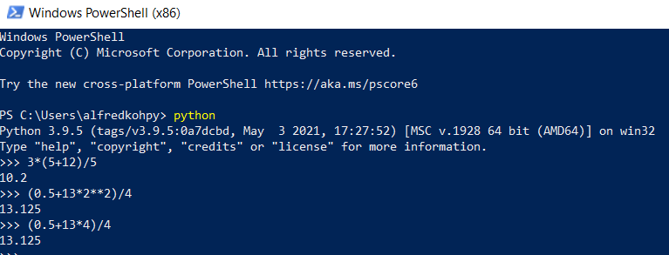
Activity (Answer)
Start Python from your command app and find the result of the following mathematical task:
$3(5+12)/5$
$(0.5+13×2^{2})/4$

Slide 25
Discussion
How do we carry out mathematical calculations in Python? How similar is it in comparison to formulas written on paper?
What are the rules that a Python variable name must follow?
What is the difference between an integer and a float variable?

Slide 26
Print and Input

Slide 27
Printing
One main task of a computer program is to show information to the user while it is running.
Use print() function to generate screen output.
For both pre-defined strings or expression values.
When printing strings, put the content within the quotation marks.
print("My String")
print(expression)
Notes:
Writing programs is not only to automate routine operations by the computer.
It is also of interest to show the results, information, or messages to the user while the Python program is running.
We can use the print() function to generate screen output for the user to read.
In the print function, we can use a pre-defined string or any expression as the printing content.
If it is an expression, it will be evaluated during runtime and the value in it will be printed to the screen.

Slide 28
Formatted Printing
Formatted printing combines pre-defined strings with values of expressions for screen output.
The combination of pre-defined strings with values of expressions is also called formatted string.
Add an “f” before the open quotation mark of the printing string.
Wrap the expressions within a pair of curly brackets {}.
Another option for formatted printing is the .format() method.
The .format() method only takes one expression in its argument.
print(f"My String {expression1} {expression2} …")
print("My String {}").format(expression)
Notes:
If we ask Python to execute the mathematical operation score1 + score2, and then print it out to the screen, it will look a bit “cold” and rather not interactive to the user.
To make such an output to look more like a statement addressing to the user, we can mix a statement with variables or expressions in our printing string to become a formatted string for printing, or formatted printing.
The print command is almost identical to the one for normal printing. The only difference here is to put an “f” before the open quotation mark.
Subsequently, we can place the variables or expressions that we would like to print anywhere within the text and wrap it within a pair of curly brackets {}.
We can also use the .format() method as another possibility for formatted printing. Note that the .format() method only takes one expression in its argument.
For the .format() method, we need to place the curly brackets at the position within the string where we would like to print our expression.

Slide 29
Escape Sequences (I)
Use escape sequences to print special characters that
are invisible such as ENTER or linebreak (\n).
cause syntax error such as single (') or double quotation marks within a string which is wrapped within the same type of quotation marks.
Suppose a string is put in a double quotation mark, to avoid the error:
Use single quotation marks within the string.
Use escape sequences \" within the string instead of switching between single and double quotation marks.
Notes:
Escape sequences are used to print special characters that are invisible such as ENTER, or characters that can cause syntax error such as single (') or double quotation marks (").

Slide 30
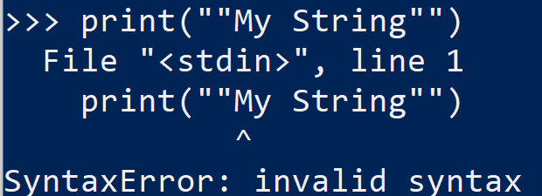
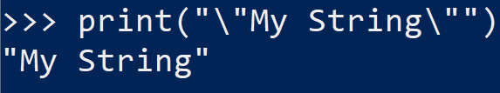
Example of escape sequences
Double quotations causes errors without using escape sequences
Double quotations does not cause errors with escape sequences

Slide 31
Escape Sequences (II)
Escape Sequences | Description
\newline | Backslash and newline ignored
\\ | Backslash (\)
\' | Single quote (')
\" | Double quote (")
\n | ENTER or line break
\b | Backspace (BS)
\t | Horizontal Tab (TAB)
\v | Vertical Tab (VT)
Notes:
Here is a list of some escape sequences in Python.

Slide 32
Input
Assign values to variables using user input during run time.
It requires users to type in something and then press ENTER.
It is allowed to use formatted strings in input().
Values assigned by an input() function are stored as string.
Convert string variables to become integer or float:
Both int() or float() only work if the input is a number.
variable = input("My String")
variable = int(input("My String"))
variable = float(input("My String"))
Notes:
While a program script is being executed, it requires values to be assigned to the variables in order to proceed in its instructions.
So far, we have discussed the possibility to assign values to the variables in the script. That means, the values are fixed when the program started to run.
However, in most of the cases, those values are unknown and can only be assigned while the program is running, mostly based on the input of the user.
In Python, we can use the input() function to ask the user to enter the value for a variable.
The whole syntax will be put on the right-hand side of an equal sign so that Python can assign the user’s input to the variable that is defined on the left-hand side of the same equal sign.
Unlike the print() function, Python requires the user to type in something and then press ENTER to complete the execution of the input() function.
Same as the print() function, we can instruct Python to print a string to the screen within the input() function. Usually, this string should be a question and/or some instructions to inform the user what they shall input here.
Furthermore, we are also allowed to mix the assigned values of some variables with the instruction text to become a formatted string that will be printed on the screen for the subsequent input.
In Python, the value assigned by the user within an input() function will be stored as string. If the input should be an integer or a number with a floating point, we can convert the input.
The functions int() and float() are used to convert a string variable to become an integer or a float variable. (Conversely, there is the str() function to convert an integer or a float variable into a string variable.)

Slide 33
Activity
Car sales program:
Create a program in which the user is asked to enter the brand, model and selling price of a car. Print the information in one print() command subsequently using formatting printing.

Slide 34
Discussion
Why is it not possible to use double quotation marks within a string which is defined by double quotation marks as well?
What are the typical applications of escape sequences?
Notes:
Here are some reflection questions to the content of this recording:
What is the difference between formatted printing using .format() method and adding an “f” before the printing string?
Why is it not possible to use double quotation marks within a string which is defined by double quotation marks as well?
What are the typical applications of escape sequences?
Why are the values entered by the users stored as strings in Python?

Slide 35
If-elif-else-Conditions

Slide 36
Boolean Expressions
Boolean expression has two outcomes: True or False.
Result of a single or multiple relational operations.
Multiple relational operations are combined by logical operators.
Examples of Relational Operation:
Relational Operation | Result
1 == 1 | True
3 > 2 | True
0 <= -5 | False
a + b < 10 | False if a + b >= 10
Notes:
To automate a routine by a computer program, we usually need to let the program “decide” what to execute in the next step based on some conditions.
For instance, the user can choose to stay or quit the program after certain operations have been completed.
Before introducing the if-elif-else-conditions that Python uses to decide how the program should behave after a certain stage of the code, we need to get ourselves familiarised with the Boolean expressions first.
Boolean variables have only two possible values: True and False.
So, the basic concept of the conditional control flow is to evaluate whether a Boolean expression is True or not first, and then carry out either set of instructions depending on the evaluation.
A Boolean expression can be the result of a relational operation or combining the results of multiple relational operations by logical operators. Here are some relational operation examples.
In these examples, the first two operations are obviously True since they correspond to the mathematical relationship between the left-hand and the right-hand side of the equations.
Note that if we would like to check whether two expressions are identical, we have to use the double equal sign (==) instead of the ordinary equal sign (=) since the single equal sign is used for assigning value to a variable.
So, if we wrote 1 = 1 instead of 1 == 1, a syntax error would return since Python would interpret our intension to be assigning a value to a number, which we know is not allowed.

Slide 37
Relational Operators
To check equality of two expressions, use double equal sign (==).
Single equal sign (=) is used for assigning value to a variable.
List of Relational Operators in Python:
Operator | Description
== | True if the values of two operands are equal.
!= or <> | True if values of two operands are not equal.
> | True if left operand is greater than right operand.
< | True if left operand is less than right operand.
>= | True if left operand is greater than or equal to right operand.
<= | True if left operand is less than or equal to right operand.
Notes:
Here is a list of relational operators that we use in Python.

Slide 38
Logical Operators
Multiple relational operations are connected by the logical operators.
Below is a list of logical operators in Python:
Operator | Description
and | If both the operands are true, condition becomes true.
or | If any of the two operands are True, condition becomes true.
not | Used to reverse the logical state of its operand.
Notes:
A Boolean expression can also be a combination of multiple relational operations, connected by the logical operators. Here is a list of logical operators in Python.
The use of a single logical operations is usually quite straightforward as they are designed in a way that it just simply matches our spoken language.

Slide 39
Boolean Expressions: Examples
The following Boolean expressions are equivalent:
(a or b) and c | <==> | (a and c) or (b and c)
(a and b) or c | <==> | (a or c) and (b or c)
not(a or b) | <==> | (not a) and (not b)
not(a and b) | <==> | (not a) or (not b)
Notes:
However, it can become quite confusing if we combine these operators in a Boolean expression.
Here are some examples of equivalent Boolean expressions.

Slide 40
if-block
Boolean expressions are embedded in if-conditional statement.
The result of the expression changes the program’s behaviour dynamically.
If condition is True, instructions will be executed.
If condition is False, Python will skip executing the if-block.
It is mandatory to put a colon directly behind the condition.
Instructions must be indented as part of the if-block.
if condition:
instructions
Notes:
The result of a Boolean expression can serve as the condition that changes the program’s behaviour dynamically by embedding it in an if-conditional statement.
In the if-condition, Python will execute the syntaxes in the instructions if the condition is True.
However, if the condition is False, Python will simply skip these lines and proceed with the subsequent code lines.
Note that it is mandatory to put the colon directly behind the condition, and the instructions must be indented so that Python can interpret them as part of the if-block.

Slide 41
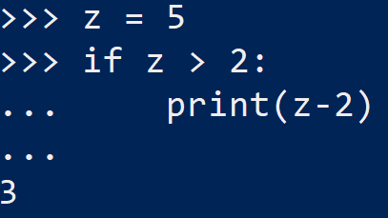
Example of an if condition
Create a variable, z = 5
If z > 2, we want python to print the value of z - 2

Slide 42
if-else-block
Execute another set of instructions if condition is False.
It is also mandatory to put a colon directly behind the else-statement.
Instructions must also be indented as part of the else-block.
if condition:
instructions 1
else:
instructions 2
Notes:
If we intend to let Python execute another set of instructions if the condition is False, and not just skip the if-block, we can add an else-statement to the if-block.
Same as the if-condition, we must add a colon to the else-statement and the instructions following it must be indented as well.

Slide 43
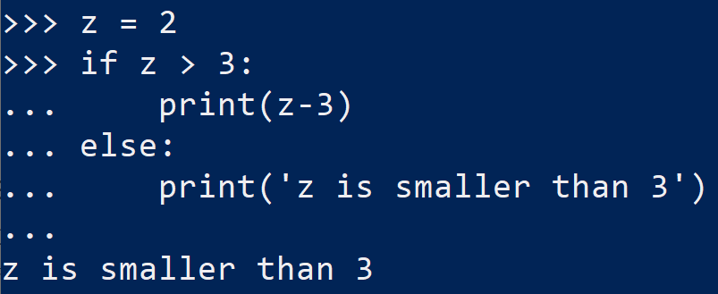
Example of if-else block
Now, we create a variable z = 2
If z > 3, we want python to print the value of z – 3
Else, we want python to print ‘z is smaller than 3’

Slide 44
if-elif-else-block
Execute multiple sets of instructions if-condition has multiple outcomes.
The else-statement is not compulsory here.
Ensure if-statement and elif-statements cover all possible outcomes.
Only omit those possibilities that do not need instructions to follow up.
if condition 1:
instructions 1
elif condition 2:
instructions 2
else:
instructions 3
Notes:
If the construction of the condition allows more than two outcomes, we may need a third, fourth, or even more if-blocks. In this case, we can use the if-elif-else-block.
Note that an if-elif-else-block does not necessarily need an else-statement.
But we should ensure that the conditions being checked by the if-statement and elif-statements must cover all possible outcomes, unless we are certain that only those possibilities are being uncovered which do not need any instructions to follow up.

Slide 45
Activity
Car sales program:
Extend the Car sales program created in the previous chapter with the following functionality:
After entering the brand, model and price of the first car, the user is required to answer they would like enter the same information of a second car. If the user’s reply is yes, ask the user those questions from the previous chapter again. If his reply is no, end the program.

Slide 46
Discussion
How do parentheses affect the outcome of a Boolean expression in which logical operators are involved?
When is it sensible just to omit the elif-and/or else-statements in an if-block? When does it make sense to include them?

Slide 47
Loops

Slide 48
while-Loops
Loops is used to repeat instructions that will be applied for many times.
The condition controls whether the loop will run a new iteration or not.
If it is True, Python will execute the instructions written with indentation.
Number of loops can be infinite.
The loop will be repeated as long as the condition is True.
Ensure there is an exit condition for the loop to terminate.
while condition:
instructions
Notes:
In the student score example, we construct a program in which the name and the mark of one student can be entered.
In the early stage of our example, we had scores of two students. If we let these two students to enter their names and then assigned a grade to each of them, we would have to repeat those codes twice.
We usually have even more than two students in one class. In order not to expand our codes endlessly and make it clumsy and unreadable, we can construct a loop in our program to repeat the instructions that will be applied for many times. The first type of loops that we will introduce here is the while-loops.
The condition is a Boolean expression which controls whether the loop will continue to run for a new iteration or not. If the condition is True, Python will go on to execute the instructions that are written with indentation and after the colon behind the condition.
The number of loops can be infinite and will be repeated as long as the condition is True. As a result, it is extremely important to ensure that the while-loops will be terminated at some stage by fulfilling an exit condition.

Slide 49
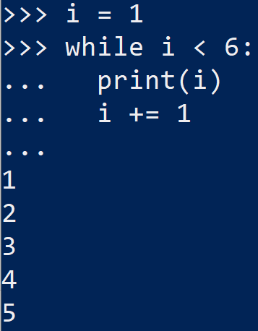
Example of while loop
Create a variable i = 1
while i < 6, print i
increase i by 1 for each iteration to prevent infinite loop
i.e., i += 1

Slide 50
Generate Integer list
A for-loop needs a list to iterate.
The number of loops is equivalent to the length of the list.
To generate a simple list of consecutive integers:
Basically, for-loop supports the iteration through any Python list.
variable = range(start, end)
Notes:
Another type of loops is the for-loops, which are constructed differently.
While we need a True-condition for the while-loops to continue to iterate, we need a list for the running of the for-loops.
Here, we will first learn to generate a simple list of consecutive integers by the range() function.

Slide 51
for-Loops
Integrate the range() function in the for-statement:
The for-command ends with a colon.
Instructions executed in each iteration are written with indentation.
Counter variable counts the iteration of the loop.
Loop ends when counter reaches end – 1.
for counter in range(start, end):
instructions
Notes:
The start value can be any integer as long as it is smaller than the end value.
Note that the end value is not included in the list. In other words, the list will end at end – 1. For the for-loops, we can integrate the range() function in the for-statement directly.
The for-command must end with a colon, followed by the instructions that should be carried out in each iteration. The instructions must be written with indentation.
The counter variable will do the counting for the iterations, starting from the start value in the first iteration and running through the entire integer list.
Once the counter reaches end – 1, Python will execute the instructions for a last time and then exit the loop.

Slide 52
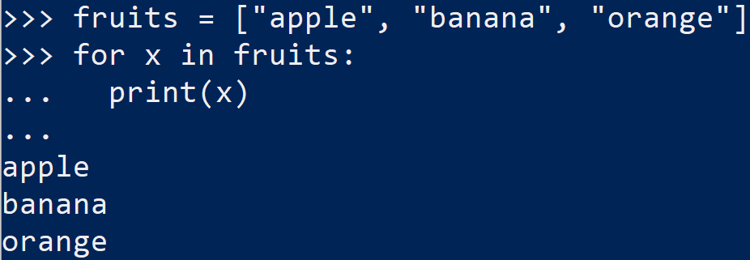
Example of for-loop
Create a list of fruits = [‘apple’, ‘orange’, ‘banana’]
For each element in fruits, print the element

Slide 53
Breaking from Loops
Python allows breaking from loops by force:
break is usually used together with if-condition.
Only break from a loop under special circumstances, not in general.
while conditions:
…
if conditions:
break
for counter in range(start, end):
…
if conditions:
break
Notes:
Though we usually have a clear exit condition or a finite list to guarantee a loop to end at a certain point of the program, we may still confront with situations where we would like to break the loop and continue with the program subsequent to the loop.
In our previous example, suppose we would like to quit the entire program after entering the first student’s data due to some reasons, although the program allows us to enter the data for up to three students.
It would be reasonable to have a syntax that allows us to break from the loop in a “clean” manner instead of shutting down the computer entirely. The command for such situation is break.
Equivalently, the break command also works within a while-loop.
Usually, break is used together with an if-condition since we would only want to break from a loop under some circumstances, and not in general.

Slide 54
Error Handling
Python stops executing program once error occurs.
To avoid Python from stopping the execution by force:
try:
instructions
except exception:
instructions
else:
instructions
finally:
instructions
Notes:
Another common use of loops is to control the user’s input following an input() statement.
For instance, it could happen that the user types in a letter instead of a number for the exam score by accident. In this case, we would like the user to redo the input until it is a number. As a result, we can put the input() statement within a while-loop and break from it only then, when the input of the user is valid.
Before we come to the step to build in while-loops for user inputs, we have to learn how Python handles errors.
We know that if we apply the int() function to convert a string variable that contains a non-numeric value to an integer, the program will be interrupted due to error. And the user will have to restart the program in PowerShell.
This can be very annoying if the user only makes a small mistake in one of the input fields, but he needs to re-type all the inputs from the beginning because of the interruption of the program.
The try-except-block is an important instrument in Python to handle errors.
Basically, we can put any syntax in the try-block if we think error can occur in those syntaxes.
The except-block is to tell Python to continue with the program except for the occurrence of an error, or the occurrence of a specific error that we declare under exception.
If error indeed occurs, Python will carry out the instructions written after the colon behind the except-statement, instead of stopping the program entirely.
The else-block and finally-block are optional and can be used if we want certain instructions to be carried out if no error occurs or for finalising a try-block.

Slide 55
Exceptions
List of some common built-in exceptions in Python:
Exception | Description
NameError | Raised when a local or global name is not found. This applies only to unqualified names. The associated value is an error message that includes the name that could not be found.
TypeError | Raised when an operation or function is applied to an object of inappropriate type. The associated value is a string giving details about the type mismatch.
ValueError | Raised when an operation or function receives an argument that has the right type but an inappropriate value, and the situation is not described by a more precise exception.
Notes:
In Python, there are many built-in exceptions. We recommend you visit the official Python website to get the entire list. The table here contains some common exceptions.
If the user is asked to enter a numeric value such as an exam score, but enter a string instead, we can use ValueError as our exception.

Slide 56
Error Handling in Input
Construct a while-loop around a try-block to handle errors.
The loop condition indicates the validity of an input.
If this Boolean variable is True (input is valid), the program will break from the loop.
Notes:
After defining the try-block to instruct Python on how to handle errors, we can construct a while-loop around it.
As condition for the loop to continue iterating is when a Boolean variable that indicates a valid input does not change from False to True.
Hence, if this Boolean variable is True, the program will break from the loop.

Slide 57
Activity
Car sales program:
Extend the Car sales program by using a loop to let the user enter the information of as many cars as he wants. The program will only end if the user answers the question whether he wants to quit the program or not with “yes”. Note that the program must also control the validity of the input (i.e., the selling price of a car must be numeric, etc.).

Slide 58
Discussion
What is the main difference between a while-loop and a for-loop?
When do we need to use the break command to break out from a loop although all exit conditions are working properly?

